Slide 1
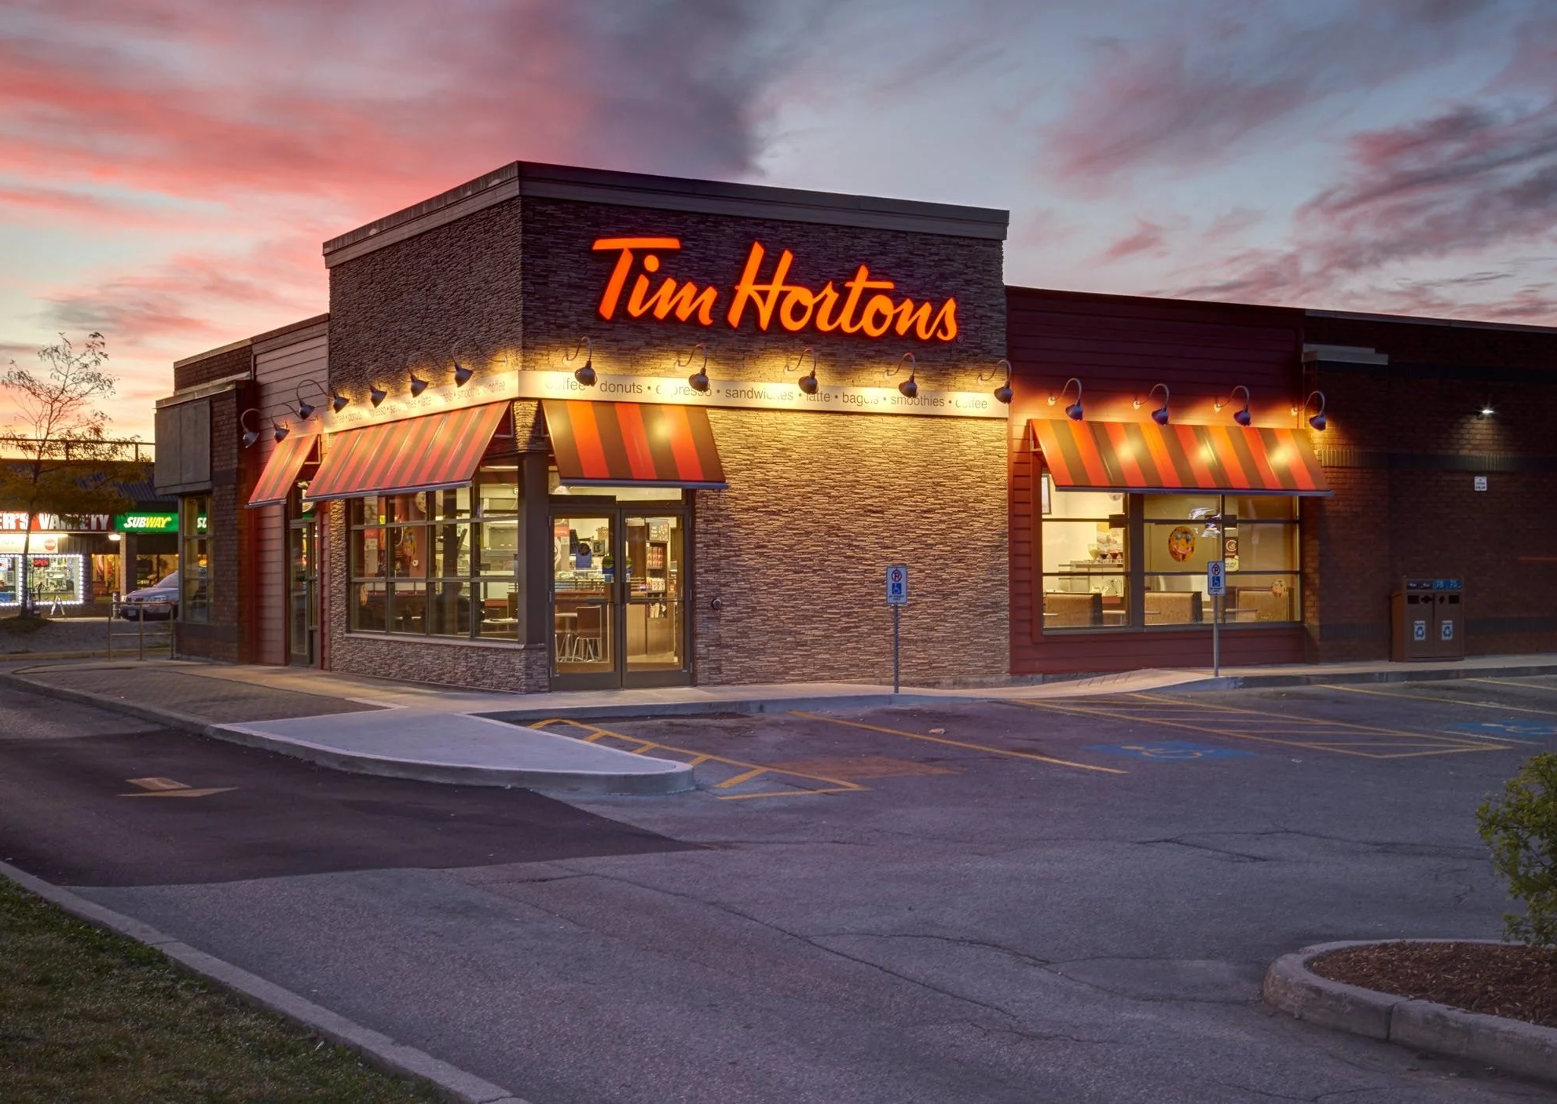
“Optimizing Operational Efficiency and Inventory Management for Tim Hortons”

Slide 2
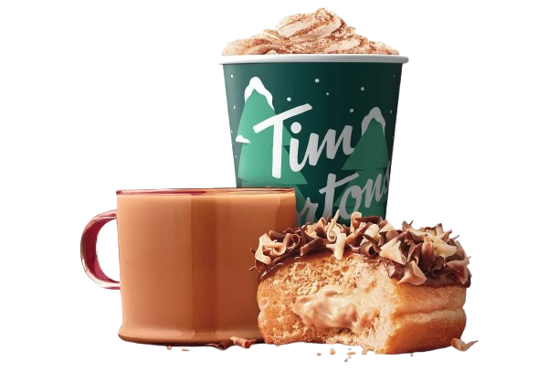
Introduction
Overview of Tim Hortons:
Tim Hortons is a well-known Canadian multinational coffee and restaurant chain, with thousands of locations across Canada and globally. The company is famous for its coffee, donuts, and other food offerings.
Project Goal:
This project focuses on optimizing operational efficiency and inventory management at Tim Hortons by analyzing various operational datasets. The aim is to provide actionable insights that will help reduce waste, improve inventory management, and ultimately enhance the store's profitability.

Slide 3
Problem Statement/Research Question(s):
Problem:
How can Tim Hortons optimize its inventory management process to reduce waste and improve operational efficiency?
What is the relationship between waste, sales, and labor costs?
Research Questions:
How does waste impact net sales at Tim Hortons?
What factors contribute to waste, and how can these be mitigated?
How can operational efficiency (in terms of sales, labor costs, and
inventory) be improved through data driven insights?

Slide 4
Dataset Information:
Data Sources:
Tim Hortons Store Data: Data shared by the store owner, Ms. Suzette Peltier, including detailed records of sales, labor hours, waste, and inventory.
Timeframe: The dataset covers operational data for the year 2022.
Data Features:
Waste Variance Report: Tracks waste percentage and cost.
Sales Per Labour Hour (SPLH): Correlates sales with labor hours.
Account Summary: Provides financial data.
Inventory Data: Includes item specific details such as pack size,
price per unit, waste units, actual vs. theoretical costs, etc.

Slide 5
Dataset Information:
Data Cleaning and Merging:
The data from the Sales Per Labour Hour and Account Summary files were merged based on Date for exploratory data analysis (EDA), while the Variance Report and Waste Report were kept on separate sheets for focused analysis.

Slide 6
Methodology
Data Cleaning:
Removal of missing or inconsistent data points.
Normalization of numerical values (e.g., prices, sales).
The IQR method was used to detect and handle outliers in key cost metrics like Actual_Cost, Theoretical_Cost, and Waste_Cost, ensuring data consistency and enhancing visualization clarity.
Outliers were managed by capping extreme values within bounds to preserve analytical integrity.
Exploratory Data Analysis (EDA):
Initial analysis of waste and sales trends.
Identifying key variables influencing operational efficiency.

Slide 7
Methodology
Correlation Analysis:
Investigating the relationship between waste, labor hours, and sales.
Visualization:
Use of Tableau for creating interactive dashboards and identifying actionable insights.
Statistical Modeling:
Regression or machine learning models to predict waste and optimize inventory management.

Slide 8
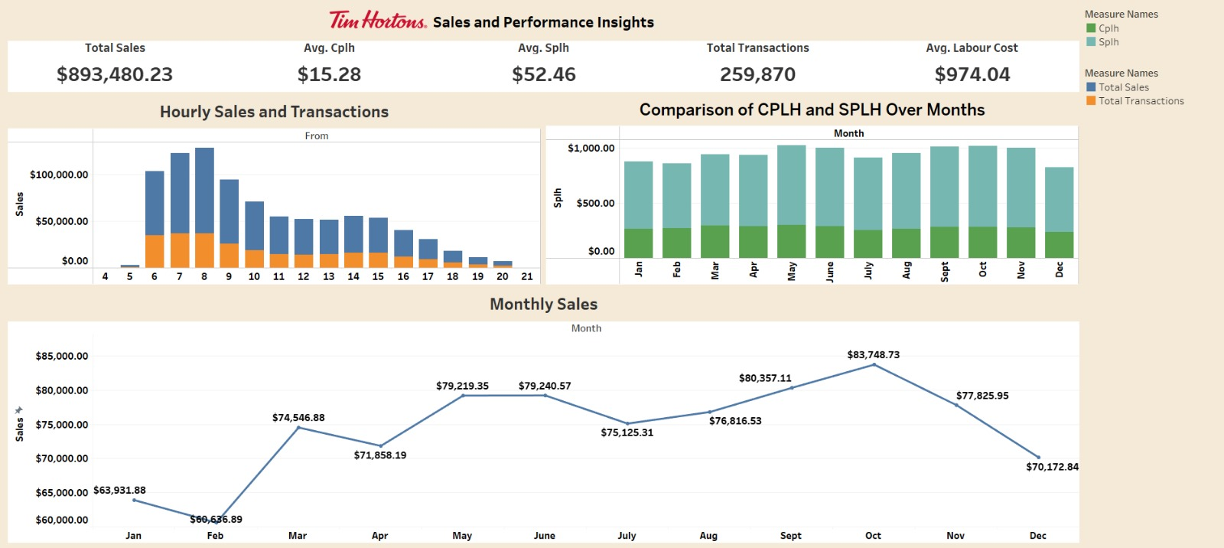
Dashboard

Slide 9
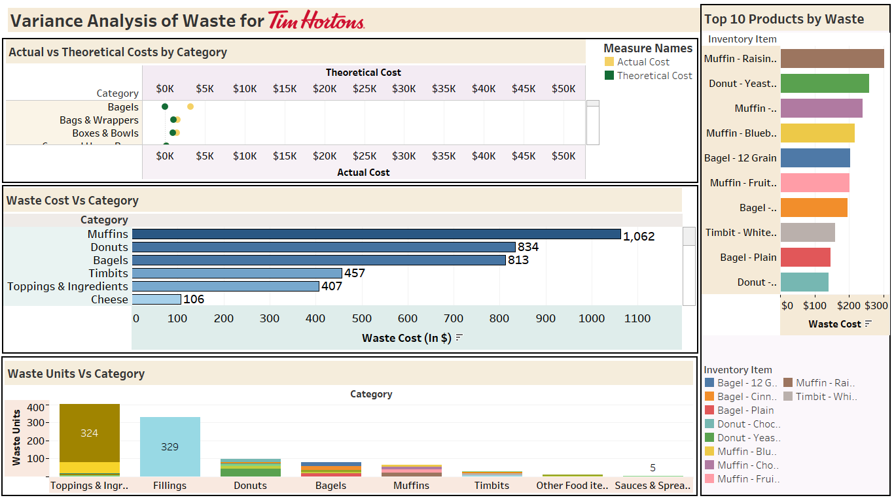
Dashboard

Slide 10
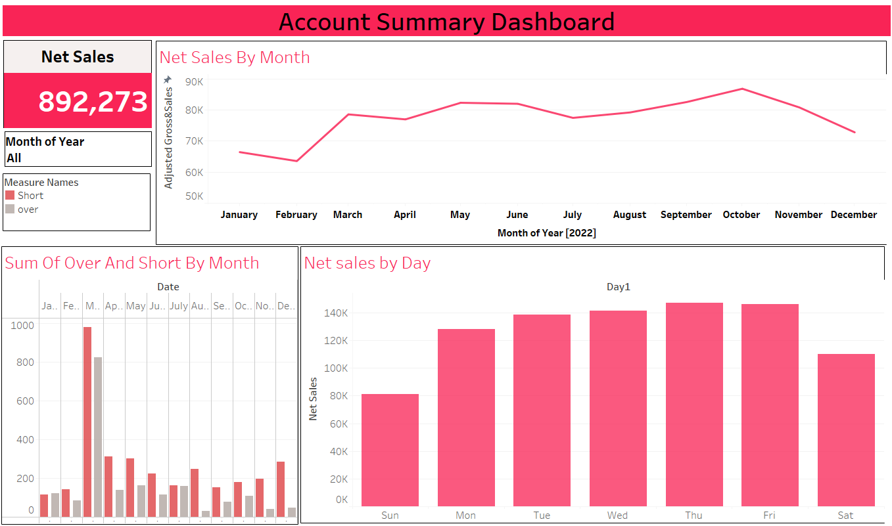
Dashboard

Slide 11
Key Insights (So Far)
Sales and Performance:
Peak Times: Sales and transactions are highest during midmorning and late afternoon.
Seasonal Trends: Sales generally increase throughout the year, peaking in October.
Customer Behavior: Customers tend to spend more per transaction over time.
Waste Analysis:
Top Waste Contributors: Muffins and Donuts are the products with the highest waste levels.
Costly Categories: Bagels and Boxes & Bowls have the highest actual costs compared to theoretical costs.
Low Waste Categories: Toppings & Ingredients and Cheese have
relatively low waste.

Slide 12
Key Insights (So Far)
Operational Efficiency: There is room for improvement in production and inventory management, especially for muffins and donuts.
Cost Control: Optimizing purchasing and packaging can help reduce costs, particularly for bagels and boxes & bowls.
Customer Satisfaction: Maintaining peak time service levels and offering attractive promotions can boost sales.
Seasonal Planning: Adjusting staffing and marketing strategies
based on seasonal trends can improve overall performance.

Slide 13
Challenges/Recommendations
Challenges:
Data Collection: Due to multiple stakeholder involvement, the store manager required thorough discussions to address data confidentiality concerns. After a productive conversation with the store owner, she approved sharing the data, ensuring alignment with privacy requirements.
Data Quality: Some records had inconsistencies or missing values, which required significant cleaning.
Data Granularity: The data could benefit from more granular tracking, especially in terms of individual product sales and waste.
Balancing multiple KPIs
(e.g., reducing waste without increasing labor costs).

Slide 14
Challenges/Recommendations
Recommendations:
Waste Reduction: Implement stricter inventory control, optimize production quantities, and improve waste disposal practices for muffins and donuts.
Cost Optimization: Negotiate better deals with suppliers, improve purchasing processes, and explore alternative packaging solutions for bagels and boxes & bowls.
Staffing Optimization: Analyze hourly sales and transaction data to optimize staffing levels.
Marketing and Promotions: Implement targeted marketing campaigns to attract customers during offpeak hours and slow months.
Product Offerings: Evaluate the product mix and consider introducing new items or seasonal specials.

Slide 15
Future Work
Further Analysis:
Perform deeper statistical analysis on the relationship between waste and labor costs to optimize staff scheduling.
Use machine learning models to predict future waste and inventory needs based on historical data.
Scalability:
Apply the developed methodology to other Tim Hortons locations for a broader impact.
Automate the dashboard to provide real time alerts for managers about waste and labor inefficiencies.

Slide 16
Thank You!
Group Members:
Nilesh Ganesh Kokulwar
Hashwanth Adapa
Priyankaben Sukhdevbhai Kaloliya
Sree Keerthi Kandula
Kaival Kiran Patel
Jaspreet Singh Saini

